Slide 1
Statistics for Mental Health Research
Intro to Stata
Gemma Knowles, PhD

Slide 2
overview
intro
getting data into Stata
do files, log files, file management
exploring the dataset
basic data management
getting help and updating Stata
practical

Slide 3
Intro

Slide 4
why use Stata?
broad suite of statistical capabilities
complete data management facilities
quick start, user friendly, easy to learn
menu and syntax-driven options
widely used = good tech support, learning resources, etc.

Slide 5
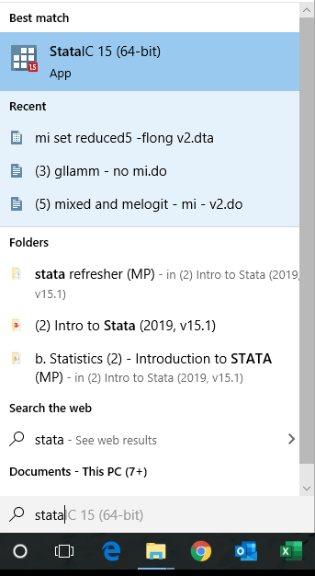
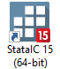
to open Stata
Applications\Stata15
double click the Stata.exe file
… or create a shortcut item of the Stata.exe file on your desktop using standard Windows procedure

Slide 6
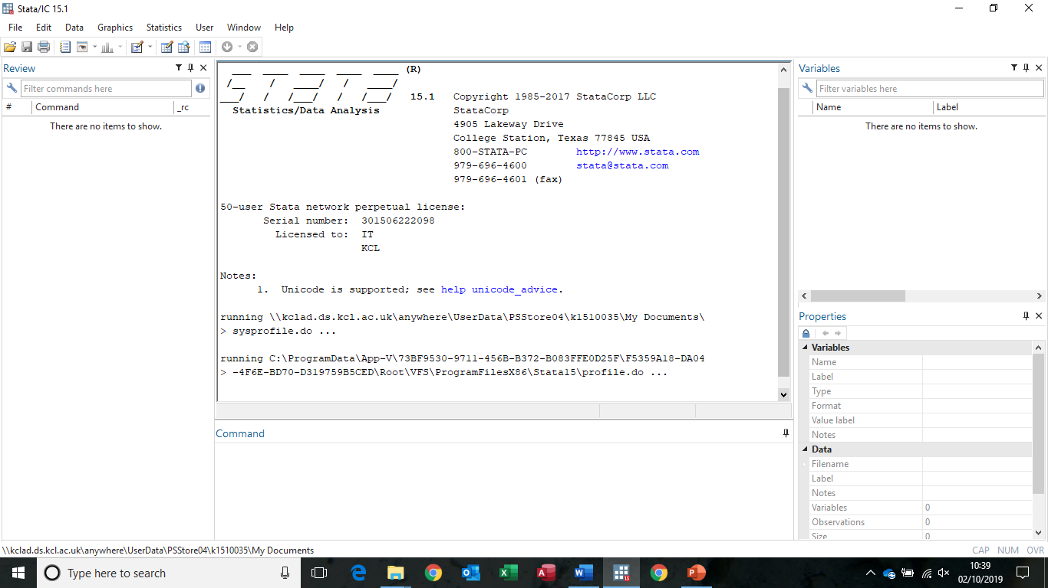
interface
variables window
review window
results window
command window

Slide 7
drop down menus

Slide 8
“do file” editor
(for building and saving commands/syntax)

Slide 9
drop down menus vs. commands: which to use?
Menu advantages:
easier for novice/infrequent users
can be easier for complex commands
can view to command options (extensions)
can get results without knowing the syntax…
…which helps you to learn the syntax

Slide 10
drop down menus vs. commands: which to use?
Command advantages:
faster if you know the command(s)
allows you to quickly and easily replicate analyses
can write “do” files.
allows programming (e.g., for customised analysis for which no inbuilt command is available)
allows macros (e.g., to repeat the same command on multiple variables without having to re-­write it).

Slide 11
version control
to tell STATA that all subsequent command lines are to be interpreted as syntax for Stata version X
e.g. version 11
ensures your do files will continue to work with future versions of Stata

Slide 12
Getting data into Stata

Slide 13
First, set the working directory
Tells Stata which file location you’re using for this session, i.e., where your work is saved (or to be saved).
click file → change working directory
or use the cd command, i.e., type:
cd “filepath\foldername”
You’ll appreciate this for some of the commands we’re about to use!

Slide 14
(1) enter data manually
The ‘data editor’
manually enter data into the data editor
copy and paste data from another source into data editor
data editor

Slide 15
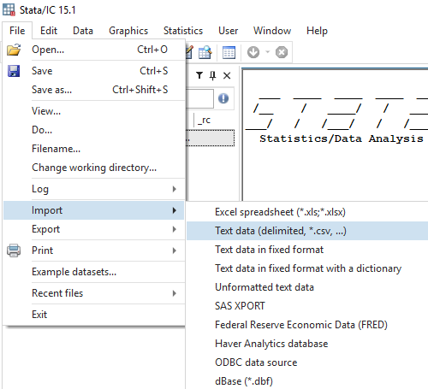
(2) load existing data, not in Stata format
Import existing data (e.g., excel) using the drop down menu: File → Import
e.g., to import an .csv file from excel

Slide 16
…or… use the import command
To import excel worksheets (*.xlsx and *.xls) into Stata, type:
import excel “filename.xlsx“, replace
To import text-delimited files (e.g., *.csv) into Stata, type:
import delimited " filename.csv", replace
Note(1): in stata syntax, everything after the comma is an ‘option’ (i.e., is optional). Note (2): in older versions of Stata (pre version 13), the import delimited command was called insheet
the replace option will overwrite any data that is currently loaded in Stata

Slide 17
SPSS and other file types
SPSS lets you save files in .dta format
There are also conversion packages (e.g. StatTransfer or DBMSCopy) available to convert data to Stata format

Slide 18

(3) load existing data, already in Stata format (.dta)
file → open from the drop down menu
or use the shortcut
or use the use command. Type:
use “filepath\filename.dta”, clear
the clear option will overwrite any data that is currently loaded in Stata

Slide 19
Stata file extensions
filename.dta = data
filename.do = “do file”
filename.smcl = “log file”

Slide 20
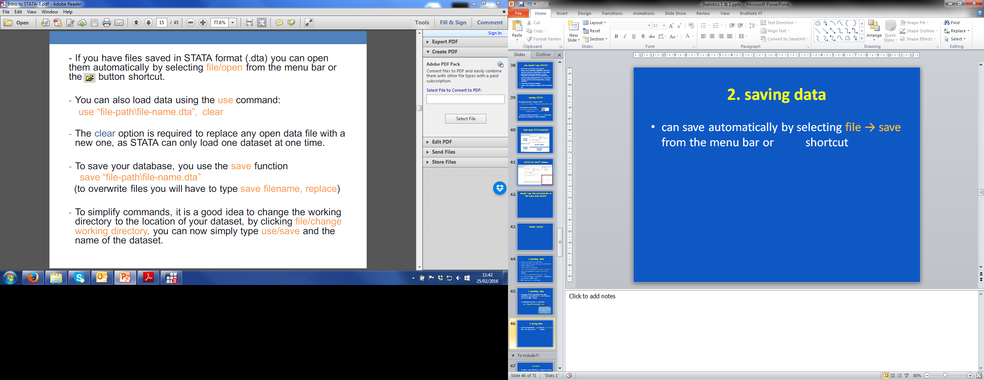
saving data
file → save from the menu bar
Or use the shortcut
or use the save command:
save “filename.dta”, replace

Slide 21
Exercise 1
create a new folder
copy the REACH excel file into the new folder
open Stata
set the working directory to this new folder
import the REACH excel file into Stata
save the file and name it exercise1
clear the Stata console
open the newly created .dta file to make sure you can access the database
Notes:
.csv comma delimited file

Slide 22
reach.csv
REACH (resilience, ethnicity and adolescent mental health) study
>4000 adolescents (age 11-14yr) taking part
All attending local secondary schools
Questionnaires at 3 timepoints
Detailed info on mental health, putative risk and protective factors, demographics – and more
reach.csv is a reduced version of the baseline dataset
Notes:
.csv comma delimited file

Slide 23
Exploring the dataset

Slide 24
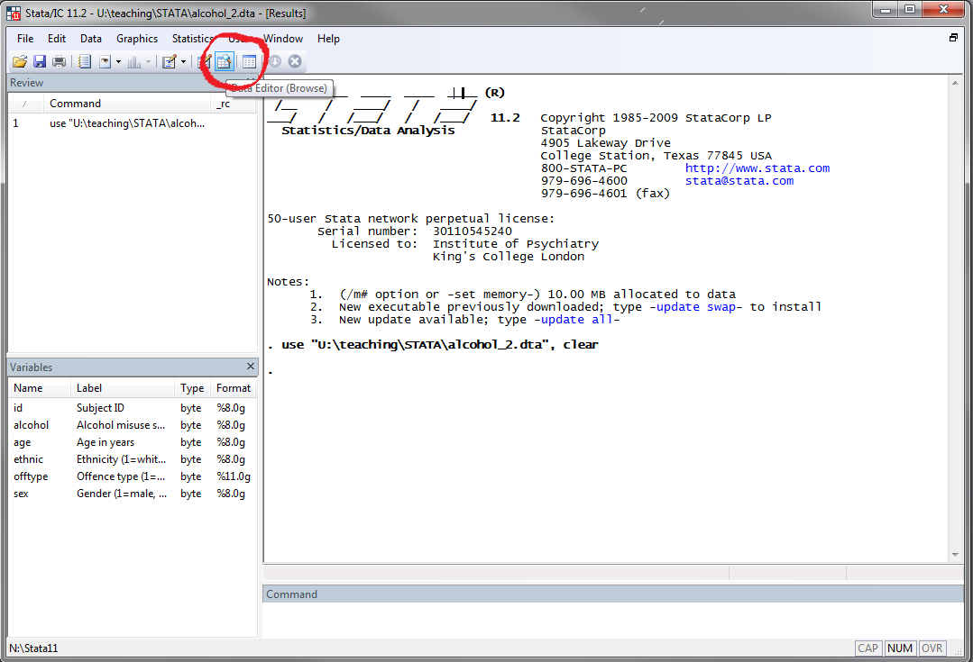
how to look at my dataset?
…or type browse

Slide 25
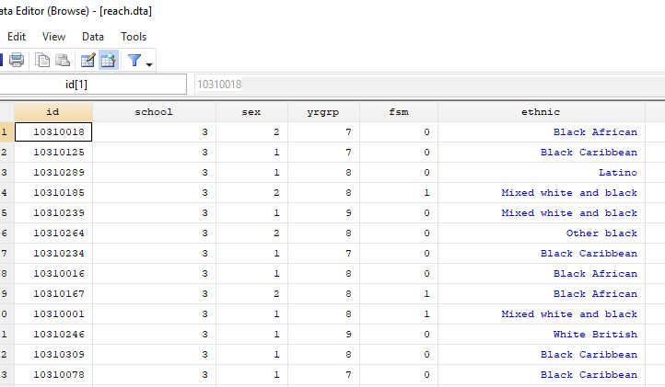
how to look at my dataset?

Slide 26
how to look at my dataset?
if you have a very large dataset and you want to visualise only a few of the variables, type browse
followed by relevant variable names, e.g.:
browse id sex ethnic

Slide 27
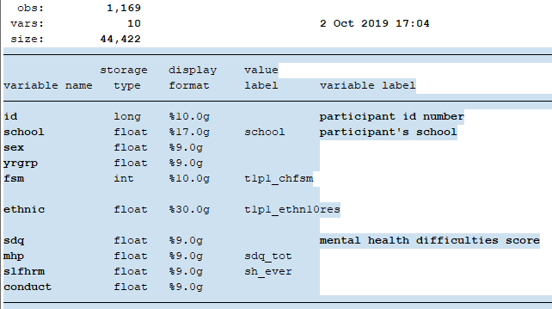
describe function
To list the variables in the dataset, type: describe

Slide 28
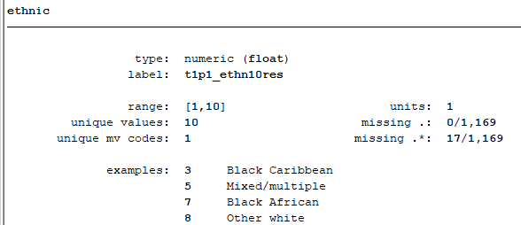
codebook function
To get a quick summary of:
all variables: codebook
(b) specific variable(s): codebook ethnic

Slide 29
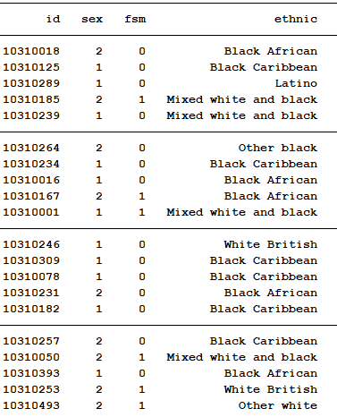
list function
To list the data for inspection:
list
variations:
list in 1/5
list sex in 1/10
list ethnic sex
list ethnic if sex==1

Slide 30
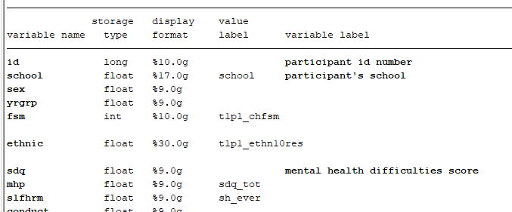
variable formats
Variables are either alphanumeric (string) or numeric (real)
In the variables window, you can look at the “type” of variable
Format column: s = string, any other letter for numeric
To obtain description of the data held in memory: describe

Slide 31
summarize function
For a summary of continuous variables, including mean, sd, etc.:
type:
summarize
or:
summarize varname, detail

Slide 32
tabulate function
For a summary of a categorical variable (n, %):
tabulate varname
To cross-tabulate two variables:
tab varname1 varname2
To cross-tabulate and add row percentages:
tab varname1 varname2, row

Slide 33

missing values
for numeric variables:
missing values are normally denoted as dots (.)
for string variables:
missing values will be blank cells
“.” are treated as an infinitely large number

Slide 34
missing values
To look at whether there is missing data:
inspect [varname]
or
codebook [varname]
or, when cross-tabbing, include missing in table:
tab [varname], missing

Slide 35
Give it a go…
What proportion have a mental health problem (mhp)?
How many missing values are there for mhp?
Codebook all the variables in the dataset. Which ones have missing values and which don’t?

Slide 36
File Management

Slide 37
log files
STATA output (except graphs) can be stored in a log file
good practice to start a new session by opening a new log file
to create a log file, type:
log using filename
you choose the filename; file will be saved to the working directory
to close the log, type:
log close

Slide 38
log files
to view a log file:
file -­> log -­> view from the menu, or
click directly on the file from your folder
to convert log file from .smcl format to .pdf format (e.g., to share it more easily with others), type:
translate filename.smcl filename.pdf

Slide 39
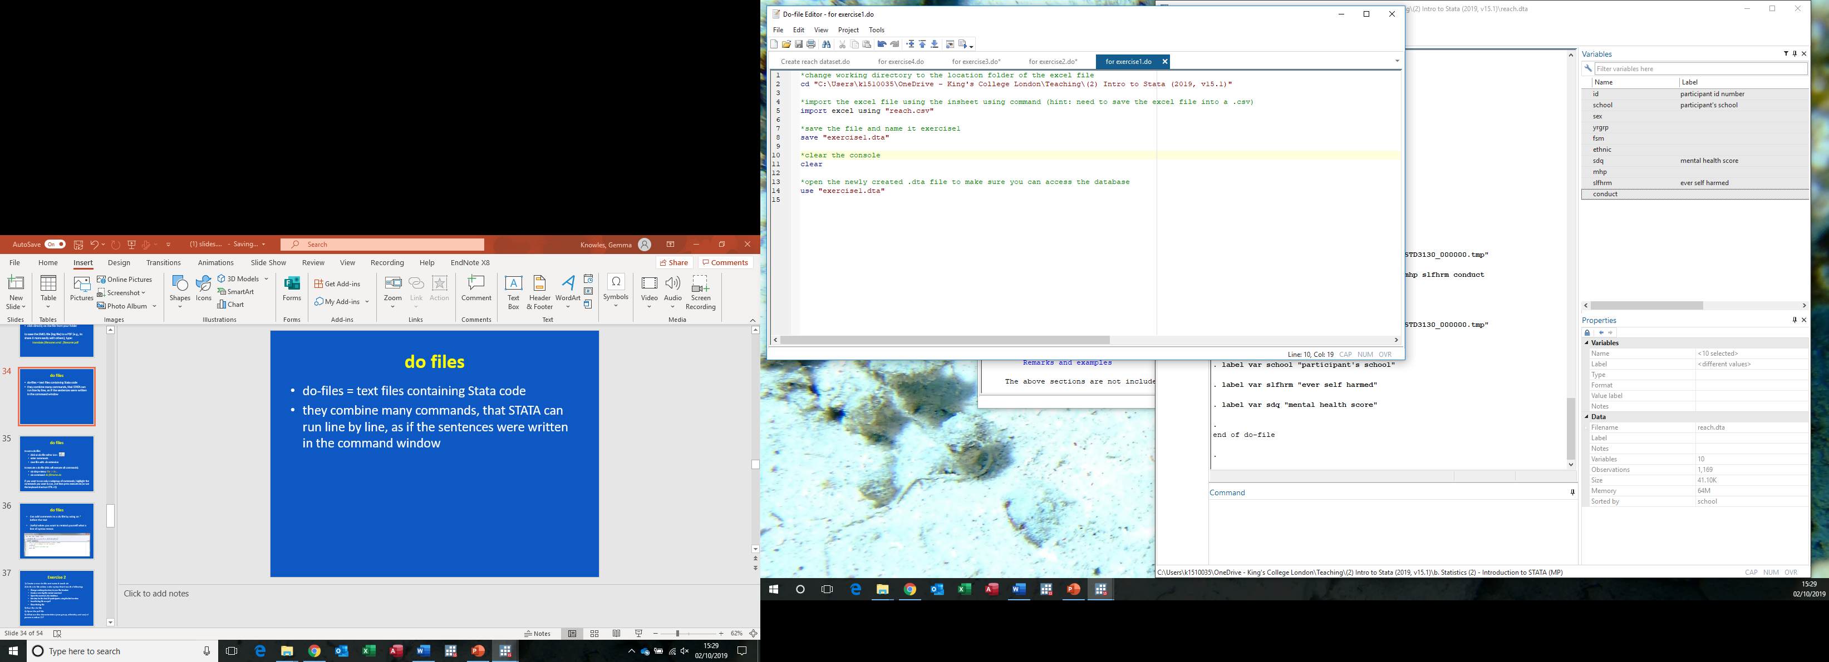
do files
do-­files = text files containing Stata code/syntax
they combine many commands, that STATA can run line by line, as if they were written in the command window

Slide 40
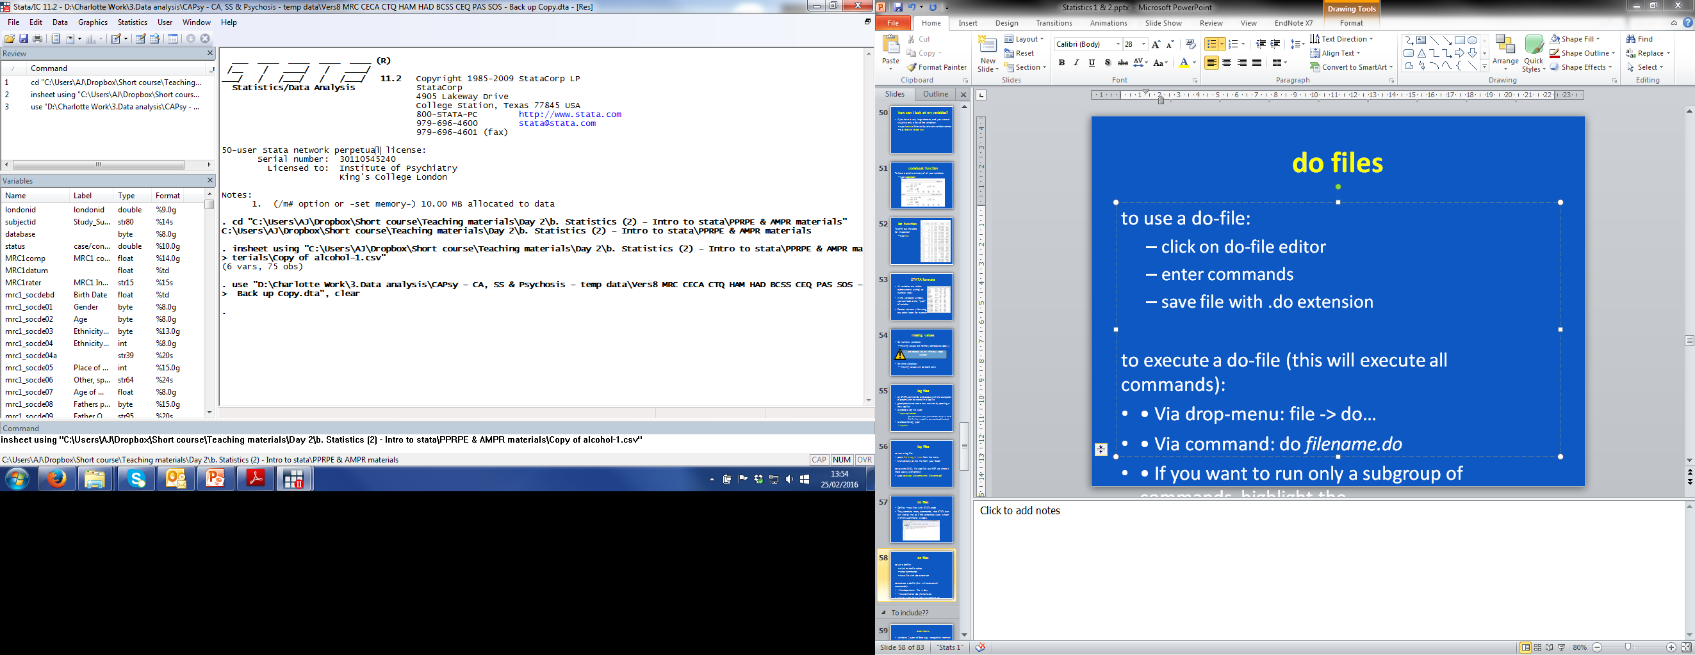
do files
to use a do-­file:
click on do-­file editor icon
enter commands
save file with .do extension
to execute specific commands:
highlight the relevant commands and press CTRL+D (or click ‘execute do’ icon)
to execute a do-­file in full (this will execute all commands):
via drop-­menu: file -­> do…
via command: do filename.do

Slide 41
annotating do files
You can add comments (green text) to your do files
Useful when you want to remind yourself what a line of syntax means
To add comments, type * at the start of the line of text or type // after a command line

Slide 42
Exercise 2
1) Create a new do-­file and name it reach.do
2) In the do file editor, write syntax that does the following:
Change working directory to your file location
Create a new log file named exercise2
Open the reach.dta database
List id, sex and ethnic for the first 20 participants using the list function
Save the log file as a pdf
Close the log file
3) Run the do-­file
4) Open the pdf file
5) What is the ethnic group of the 12th participant?

Slide 43
Stata syntax

Slide 44
Stata syntax
almost all Stata commands consist of a command name followed by a set of syntax elements
these elements always go in the same order
a general form of Stata command syntax is:
[by:] command [varlist] [if/in] [, options]
where brackets [ ] indicate optional elements (they’re not part of the syntax, don’t type them)

Slide 45
Stata syntax
Note: commands can be abbreviated when writing code/syntax
The help menus show how to abbreviate (underlined)
e.g., tabulate can be shortened to tab
generate can be shorted to gen

Slide 46
Stata syntax
The most commonly used syntax elements are:
varlist – refers to a list of variable names separated by space
option – change the default behaviour of the command to perform a specific task
if – specify a condition (e.g., to restrict the operation on a subset of the data)
in – like if, in allows the user to specify which observations are to be acted on
by – is used to run a command separately across groups

Slide 47
Stata syntax
E.g., to create a 2 by 2 table of sex and mental health problems (mhp) for school 3, by ethnic group, and reporting the results of a chi² test, you would type:
by ethnic, sort: tab sex mhp if school==3, chi
groups
command
varlist
if condition
option

Slide 48
operators
Arithmetic | Logical | Relational
+ addition | ~ not | > greater than
- subtraction | ! not | < less than
* multiplication | | or | >= > or equal
/ division | & and | <= < or equal
^ power |  | == equal
 |  | ~= not equal
 |  | != not equal
You can combine commands with relational operators or logical operators, e.g. drop if age >=30 or count if sex ==1

Slide 49

ways to re-run and stop commands
to rerun a command executed from command window:
click on previous command in review window to bring it back to the command window
or double click it to execute immediately
If using a do file, it is easier just to re-­execute the commands from the do-­file editor
An executed command can be stopped by clicking the stop button:

Slide 50
Give it a go…
what proportion of boys have a mental health problem (mhp) at school 7?

Slide 51
Time-keeping

Slide 52
Basic Data Management

Slide 53
dropping and keeping variables
to get rid of a variable:
drop varname
you can also use the drop function to drop specific observations, e.g., drop if missing(sex)
to keep only one or two variables:
keep varname1 varname2
Dropped variables cannot be retrieved. It is a good idea to preserve data before dropping any variables by (a) saving dataset with a new filename (e.g., v2), or (b) typing preserve - this way if you’ve made a mistake you can go back by typing restore.

Slide 54
organising data
(1) to rename a variable:
rename ethnic ethnicity
(2) to recode values of a variable:
e.g., if sex is coded 1=male and 2=female, and you wanted to change the coding to 0 and 1, type:
recode sex (1=0) (2=1)
if you wanted to recode missing values of age to 99:
recode age (.=99)

Slide 55
creating new variables
(3) to generate a new variable:
e.g., create a new variable called age, which equals 11 for everyone in school year 7
generate age = 11 if yrgrp==7
(4) to create variables based on summary statistics:
e.g., create a new variable called meansdq, which contains the sdq sample mean
egen meansdq = mean(sdq)

Slide 56
organising data
(5) to replace values of an existing variable
replace age = 12 if yrgrp==8

Slide 57
Exercise 3
Open the reach.dta database, if not already open
Recode all missing values of fsm to a new value, 99
After you’ve made sure you can retrieve data (e.g., save as new filename), drop the mhp variable
Recode the school variable so that those in school 3 are combined with school 7
You realise you need your mhp variable after all, and the recoding of school was a mistake. Return the dataset to the end of step 3.

Slide 58
Time-keeping

Slide 59
labelling variables
variable names are generally kept short – e.g. mhp for ‘mental health problem’
also common to name a variable with single letters, e.g. y, x1, x2, etc.
therefore we need labels…!
syntax is: label variable <varname> “<label>”
e.g. label variable mhp “mental health problem”

Slide 60
labelling values
Categorical variables can sometimes be coded with numeric values
E.g. variable sex is often coded in a binary way, such as 1=male and 2=female
If no labels have been added, whenever we list the variable sex, we just see values 1 and 2 (not male and female)

Slide 61
labelling values
You can create labels for these data values so the output will display “male” for 1 and “female” for 2, by using a two step process:
1. Create labels:
label define sx 1“male” 2“female”
2. Assign labels to values:
label values sex sx

Slide 62
Exercise 4
open reach.dta, if not already open
assign the following labels to the variables
sex: gender
yrgrp: school year group
fsm: free school meals
ethnic: ethnic group
slfhrm: lifetime self harm
mhp: mental health problem
(3) assign the following value labels to fsm and sex:
fsm: 0=high SES, 1=low SES
sex: 1=male, 2=female
(4) check it worked (codebook)

Slide 63
Getting help / updating Stata

Slide 64
Stata help
use the help command to open a window with documentation about specific commands (e.g. help tabulate)
… or via drop-­ menu:
Help →Contents… for a list of Stata commands
Help →Search… for a keyword search.
Help →Stata Command…to search for specific Stata commands.
if you are connected to the Internet and running Stata, when conducting a search you are searching both the Stata software and the Stata website

Slide 65
update / add-on packages
you can update the software to make sure it’s running the latest version by typing update all
add-­on packages can be downloaded (not so easy on university computers), e.g., typing ssc install mdesc will install the package mdesc

Slide 66
Exercise 5
Using reach.dta, answer the following questions:
(hint: tabulate)
How many boys are in the dataset?
What percentage of participants have self harmed?
What percentage of boys have self harmed?
What percentage of girls have mental health problems?
(hint: summarize)
5. What is the mean mental health difficulties score?

Slide 67
(extension practical)

